Slide 1

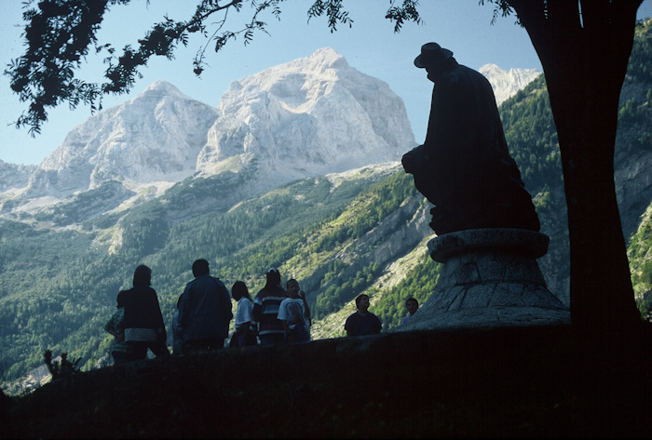
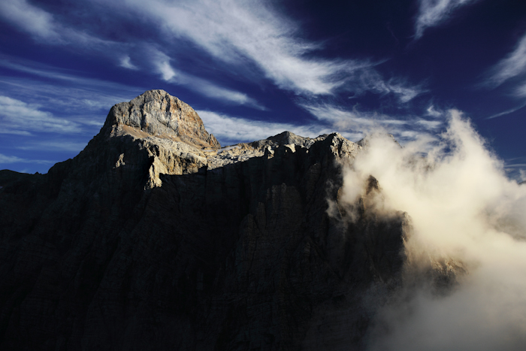
PEOPLE IN MOTION
DANILO RE 2013
IZTOK BUTINAR

Slide 2
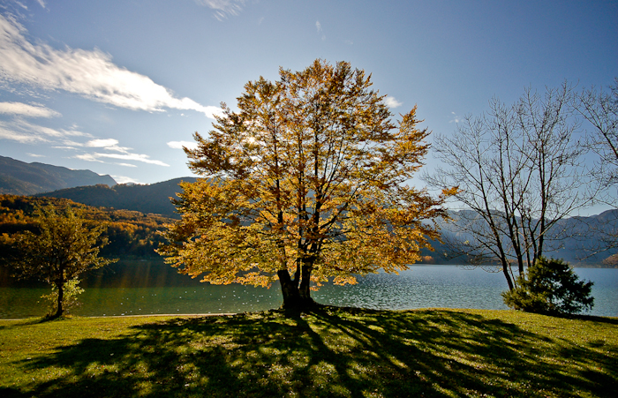
MAIN PURPOSE OF TOURISM TRIPS BY UNWTO
BUSSINES AND PROFESSIONAL
HOLIDAY, LEISURE AND RECREATION
VISITING FRIENDS AND RELATIVES
EDUCATION AND TRAINING
HEALTH AND MEDICAL CARE
RELIGION / PILGRIMAGES
SHOPPING
TRANSIT
OTHER

Slide 3
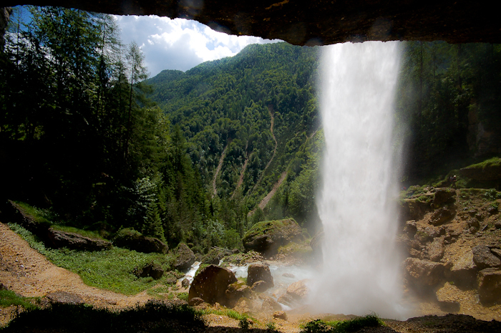
MAIN PURPOSE OF VISITING TNP
80 % OF MAIN PURPOSES OF TOURISM TRIPS
+
ECONOMICAL AND SOCIAL SITUATION
Number of daily tourists (local) in TNP increase in economical crisis

Slide 4
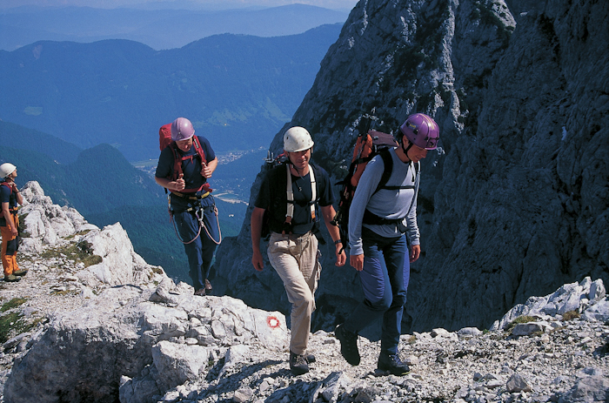
MAIN PURPOSE OF VISITING TNP
PEOPLE REDUCE OR CANCEL LUXURY...
PEOPLE HARDLY OR NEVER CANCEL THEIR HABITS – HOLIDAYS...
DECIDE FOR CLOSER AND CHEAPER DESTINATIONS FOR SHORTER PERIOD BUT FREQUENTLY - COMMUTERS

Slide 5
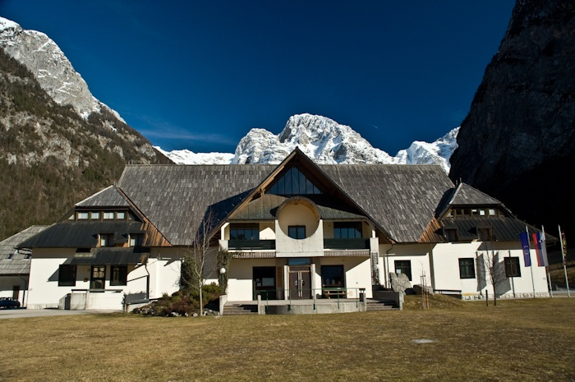
INFORMATION IN TNP
2 VISITOR CENTRES
3 INFORMATION STATIONS (basic informations)
20 professional park rangers
In high season could not cover all visitors expectations...solution?

Slide 6
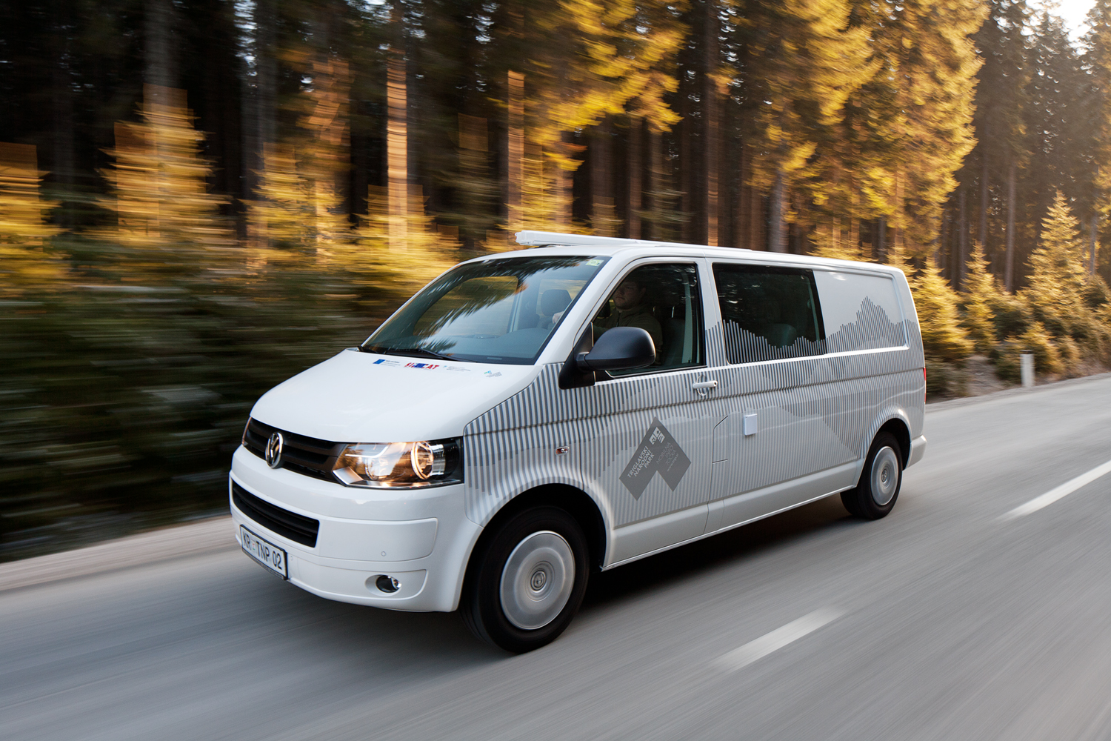
NATIONAL PARK MOBILE UNIT
4 x 4 ADAPTED MINI BUS
MULTIMEDIA EQUIPEMENT IN MINI BUS ALLOWS THE TRANSMISSION OF ANY KIND AUDIOVISUAL CONTENTS
BRIDGING THE GAP BETWEEN CENTRES, STATIONS AND RANGERS
WIDE RANGE OF USE

Slide 7
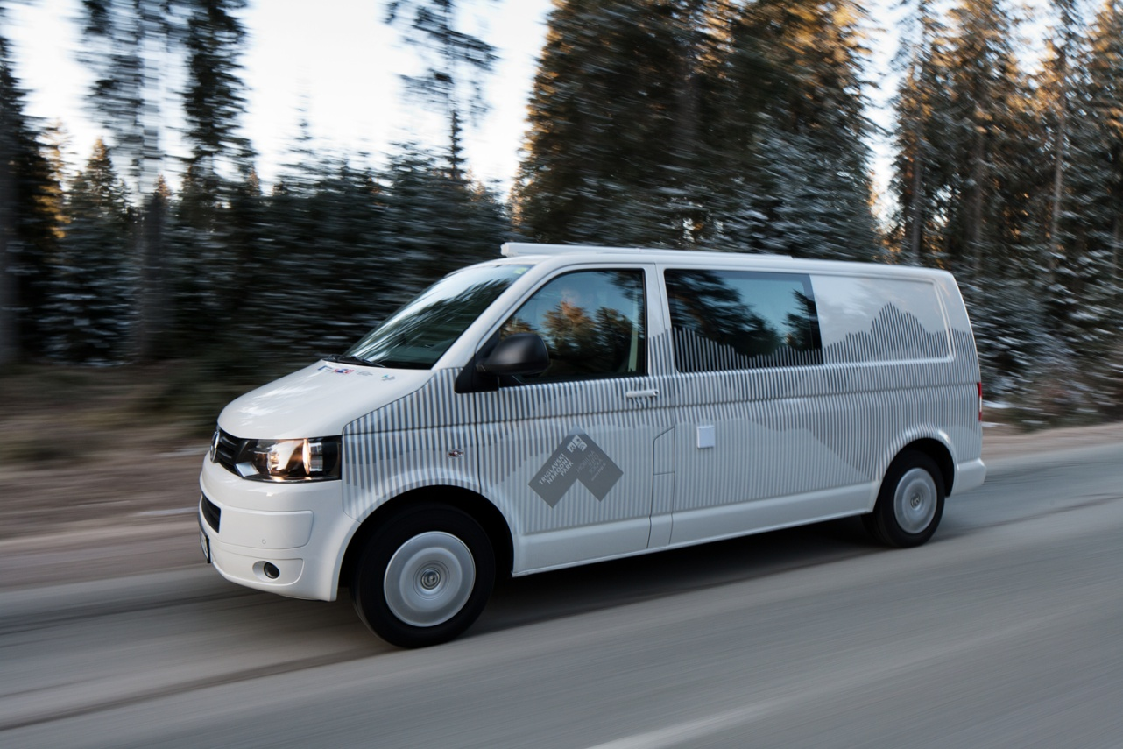
NATIONAL PARK MOBILE UNIT
PREVENTIVE TASKS THE AWARENESS OF VISITORS.
PRESENT IN ALL KEY LOCATIONS AND BASES OF NATIONAL PARK.
WINTER 2012/2013 EXPERIMENTAL VERIFICATION OF AVALANCHE BEACONS IN SEVERAL LOCATIONS AT DIFFERENT PERIODES.
SUPPORT THE INTERNET SITE WWW.PLAZOVI.INFO WITH INFORMATION ABOUT RISK TRIGGERING SNOW AVALANCHES IN THE AREA OF NATIONAL PARK.

Slide 8
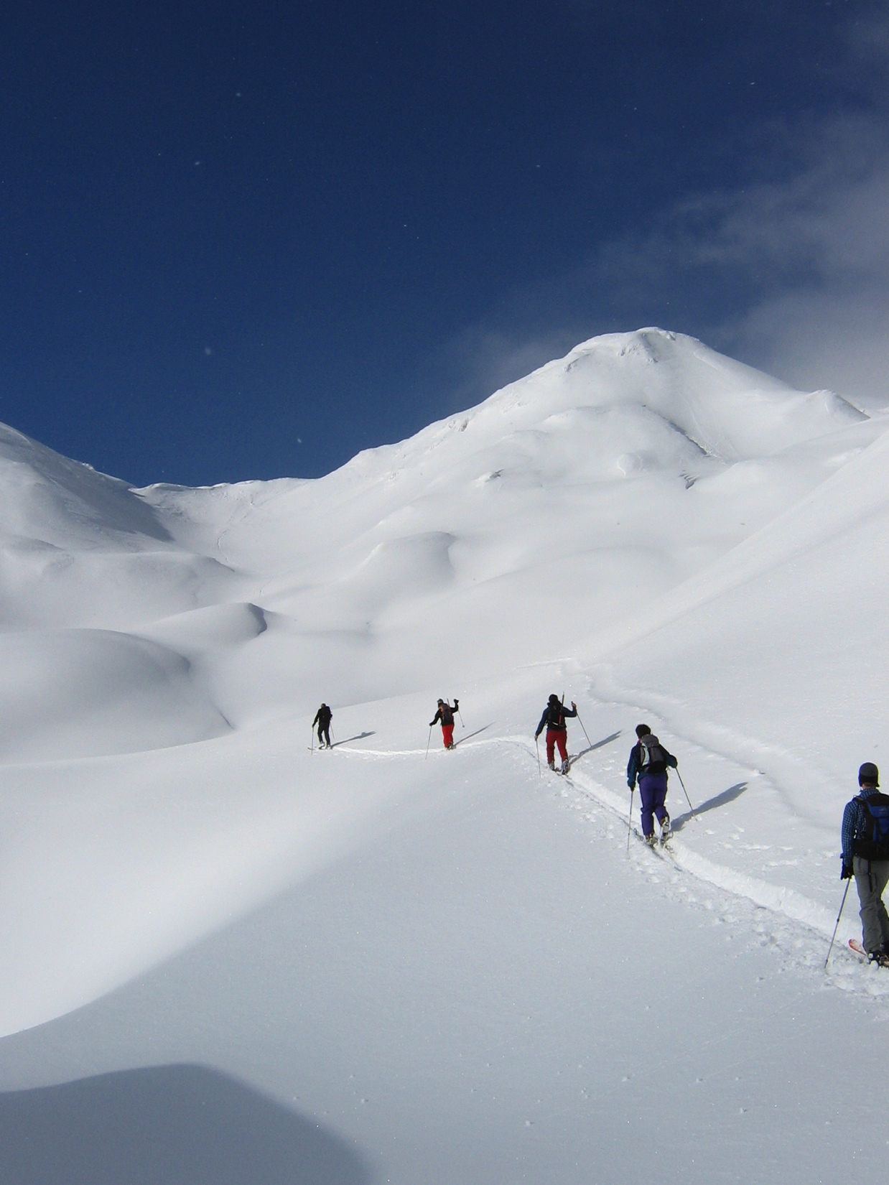
WWW.PLAZOVI.INFO –WHY ?
INCREASING NUBER OF VICTIMES IN SNOW AVALANCHES IN THE AREA OF TNP AND SLOVENIA
ONE SOURCE OF INFORMATION ABOUT RISK TRIGGERING SNOW AVALANCHES FOR THE WHOLE COUNTRY
PEOPLE HAVE GEAR BUT DO NOT KNOW HOW TO USE IT
POWDER SNOW HUNTERS
GUIDE BOOK ABOUT SNOW AND SNOW PACK

Slide 9
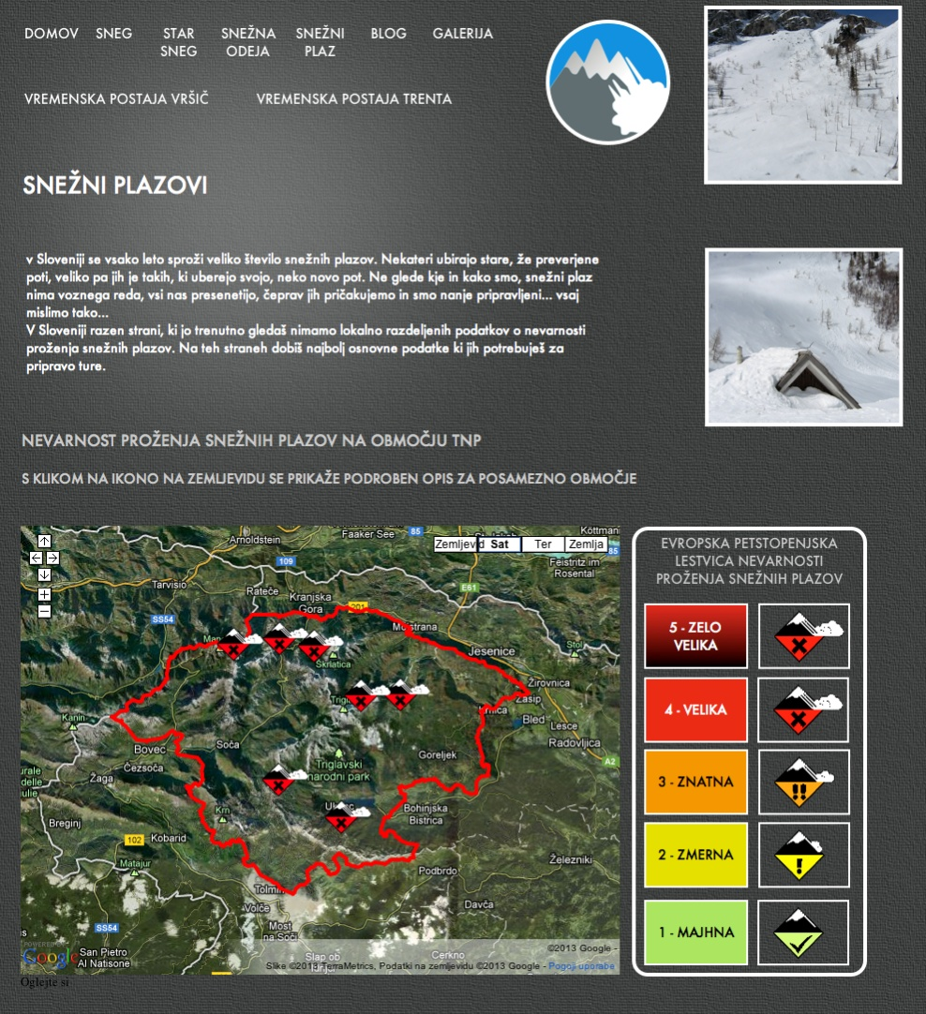
WWW.PLAZOVI.INFO-INFORMATION UPDATE SOURCES
INFORMATION ABOUT SNOW PACK FROM NATIONAL PARK RANGERS FROM DIFFERENT AREAS – LOCAL MOST IMPORTANT INFORMATION.
TWO AUTOMATIC METEOROLOGICAL STATIONS

Slide 10
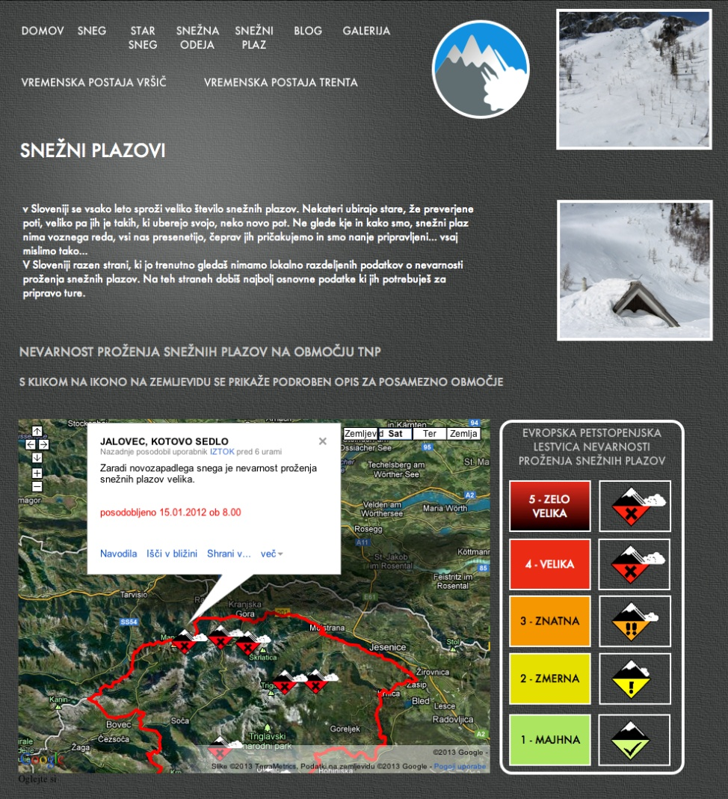
WWW.PLAZOVI.INFO IN ONE YEAR
70.000 HITS ON SITE IN ONE YEAR
LINK TO OUR SITE FROM IMPORTANT SLOVENIAN SITES: SKI CENTERS, SLOVENIAN ALPINE ASSOSIATION, SLOVENIAN MOUNTAIN RESCUE ASSOSIATION, SLOVENIAN TOURIST BOARD, SHOPS WITH MOUNTAIN GEAR, ETC....
EASY ACCESSIBLE AND CHEAP INFORMATION.

Slide 11
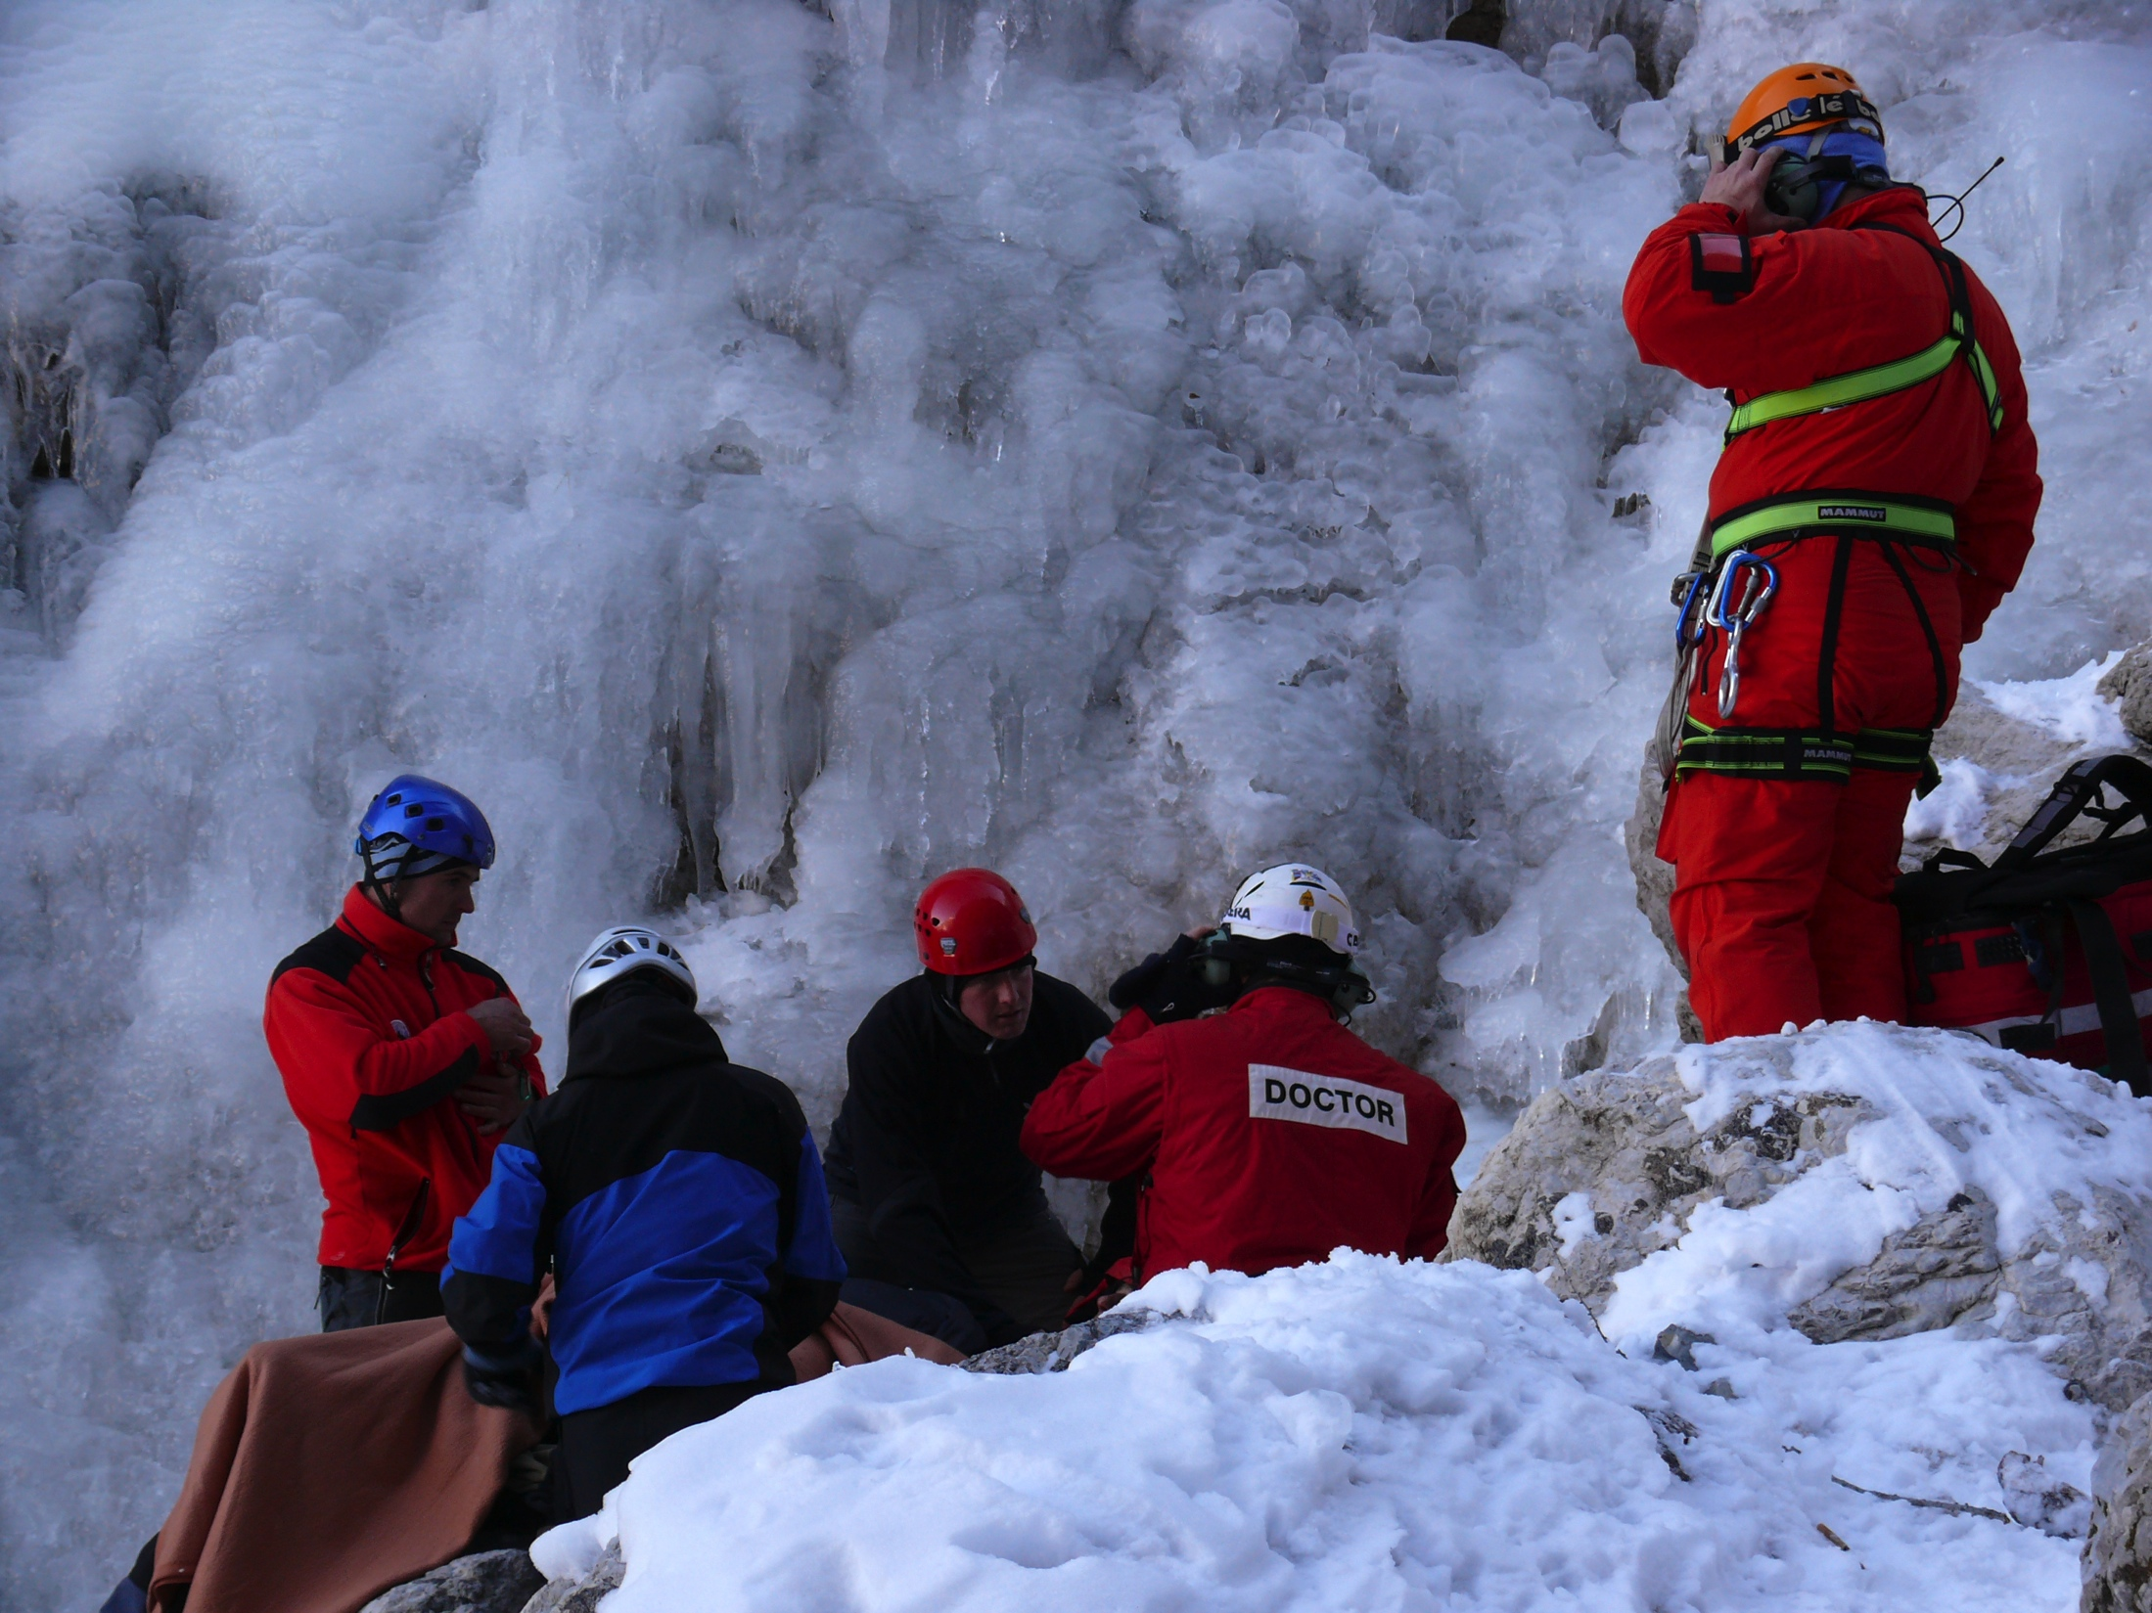
WWW.PLAZOVI.INFO - GOALS
REDUCING NUMBER OF ACCIDENTS WITH EDUCATION (WORKSHOPS FREE OF CHARGE)
REDUCING NUMBER OF VISITORS IN QUIET AREAS (1st CONSERVATION AREAS) IN WINTER PERIOD
REDUCING IMPACT ON PROTECTED AREA...
TEXT IN ENGLISH, GERMAN AND ITALIAN LANGUAGE.

Slide 12
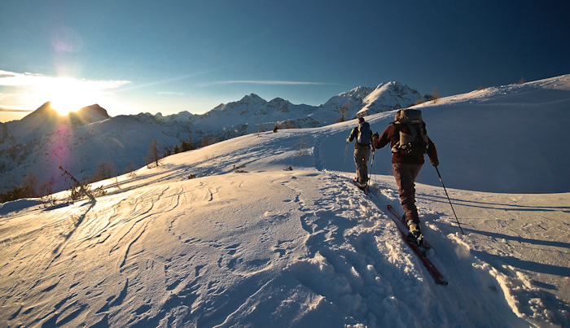
PEOPLE IN MOTION
PEOPLE WILL ALWAYS BE IN MOTION…
OUR MAIN GOAL IS STIMULATE AND GUIDE THEIR EMOTIONS…
WHEN WE WILL BE ABLE TO FIND PROPER BALANCE BETWEEN VISTORS EMOTIONS AND NATIONAL PARK TASKS WE ARE GOING TO BE ON RIGHT WAY…

Slide 13
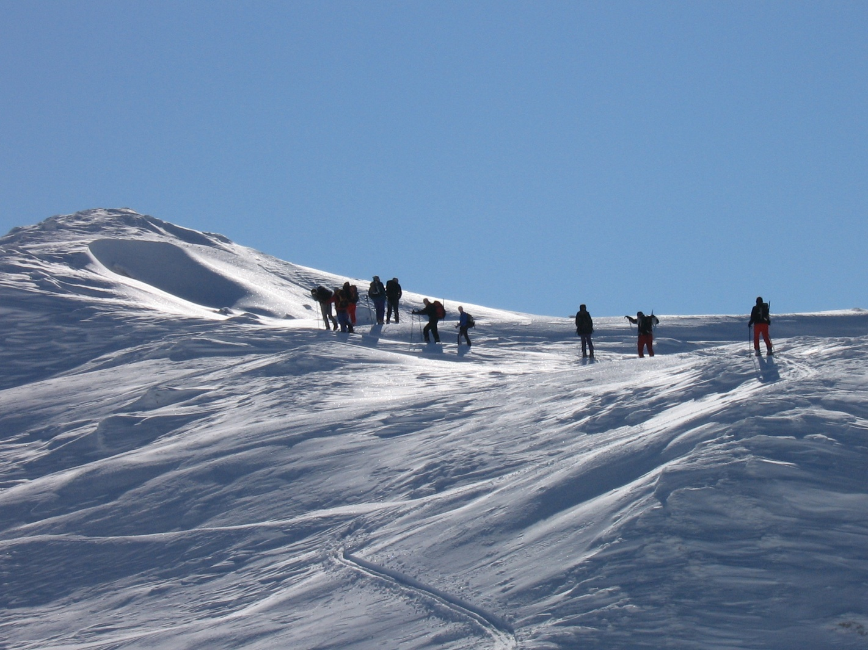
PEOPLE IN MOTION
THANK YOU VERY MUCH

